Slide 1
Index
Introduction
Abstract
Literature survey
Advantages
Data flow Diagram
Use Case Diagram
Future Scope
Summary
References

Slide 2
Introduction
Disease Prediction and Doctor Recommendation (DPDR) is a medical application that helps in predicting diseases and recommending a suitable doctor for the patient.
It utilizes big data analytics and machine learning algorithms to accurately predict diseases.
The application also provides information about the doctor such as their credentials, experience, and patient reviews.
This helps the user to make an informed decision about the doctor they should consult.

Slide 3
Abstract
The purpose of this project is create Disease prediction online and recommendation in this project doctor needs to register to this portal and user can visit to this portal and as per user symptoms system predicts the user disease and that time system will recommend the available doctor through this portal User will get perfect doctor for his disease to implement this jack we’re going to use full stack development languages like PHP, JavaScript, Bootstrap, MySQL DB, HTML and CSS.

Slide 4
Literature survey
Existing system:- According to the survey of current patients, users must go to hospital to have their illness evaluated.
Proposed System:- we are going to develop this is prediction and doctor recommendation the purpose of this project is create Disease prediction online and recommendation in this project doctor needs to register to this portal and user can visit to this portal and as per user symptoms system predicts the user disease And that time system will recommend the available doctor through this portal User will get perfect doctor for his disease to implement this jack we’re going to use full stack development languages like PHP, JavaScript, Bootstrap, MySQL DB, HTML and CSS.

Slide 5
Advantages
User will get disease information any time.
Reduce the time of user.
User will get Doctor recommendations easily.
User will get disease information anywhere.

Slide 6
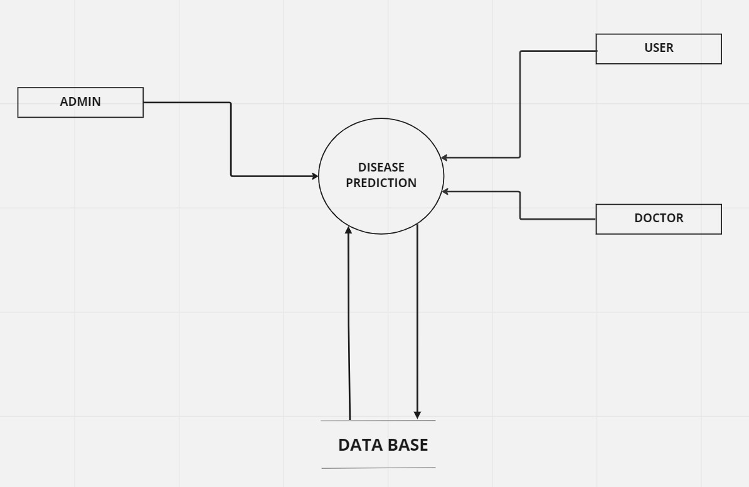
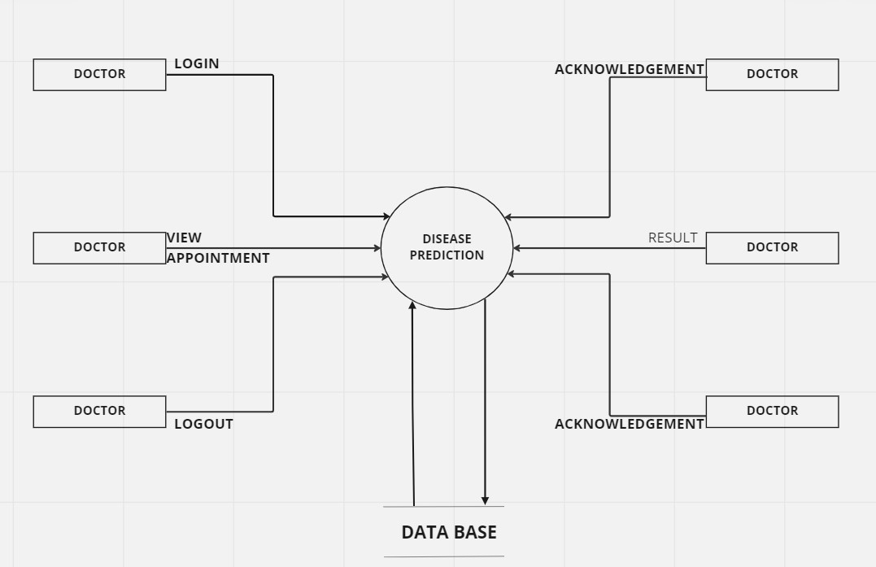
Data Flow Diagram :- level 0:- level 1:- for doctor

Slide 7
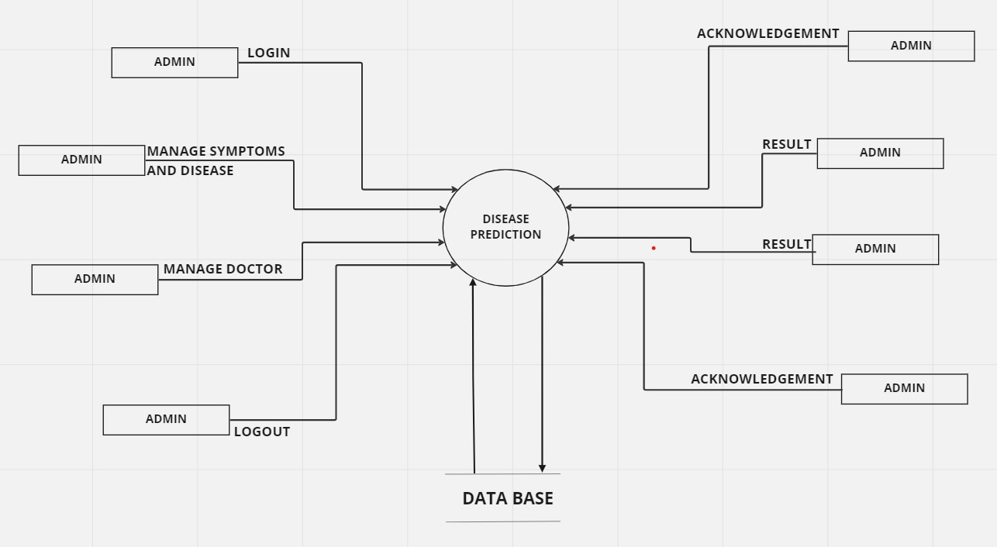
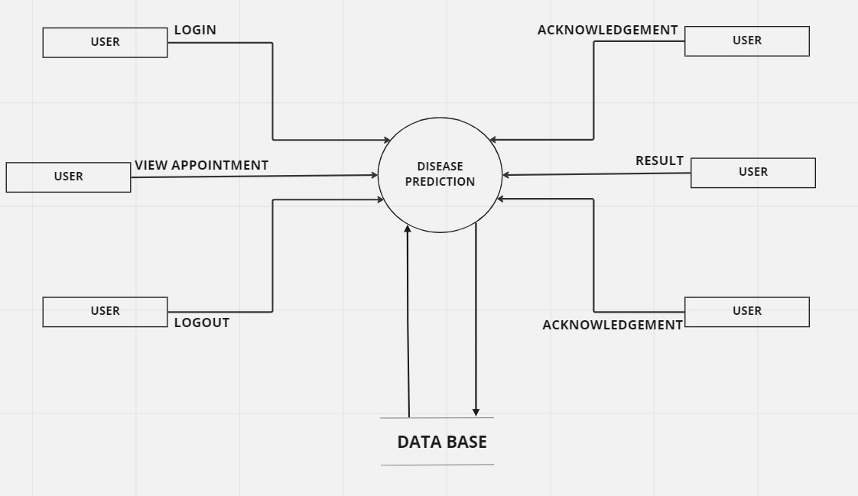
level 1:- for admin level 1:- for user

Slide 8
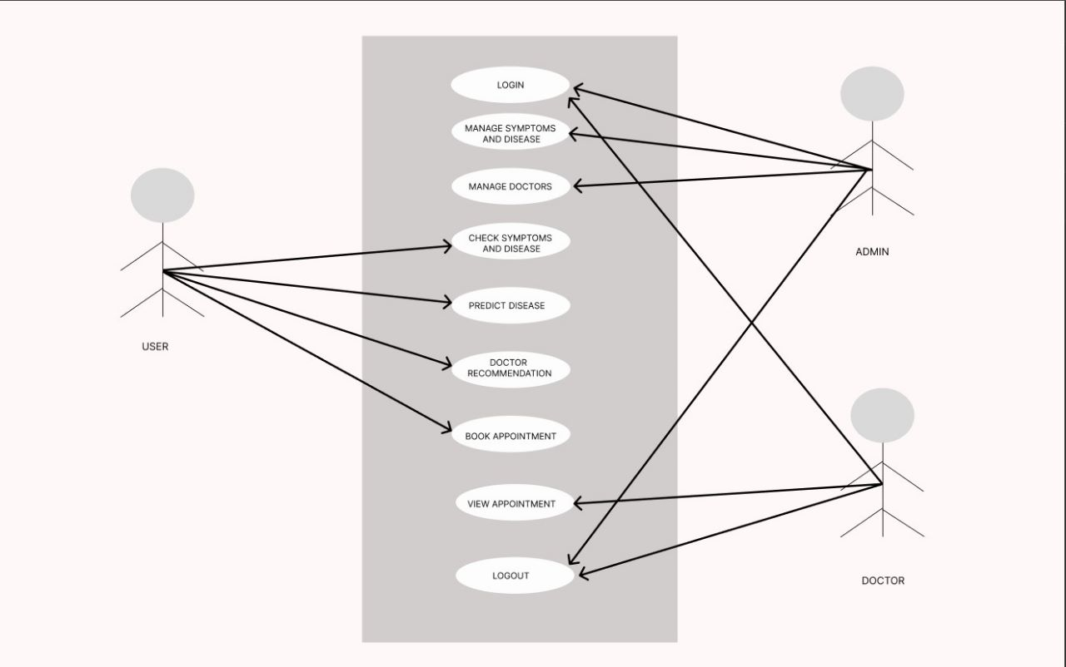
Use Case Diagram :-

Slide 9
Future Scope
In future we can implement it as Mobile Application.
We can deploy the project to any city or state.

Slide 10
Summary
As per the system we will implement the “Disease Prediction And Doctor Recommendation” portal we will implement all the modules.
User/Patient Module.
Doctor Module.
Disease Prediction.
Doctor Recommendation
Admin Login, View Doctor Error free , user-friendly.

Slide 11
References and Bibliography:-
References and Bibliography:
https://reactjs.org/
https://github.com/
https://www.w3schools.com/REACT/DEFAULT.ASP
https://www.javatpoint.com/reactjs-tutorial
https://www.simplilearn.com/tutorials/reactjs-tutorial/what-is-reactjs

